Slide 1
INTERO PARTNERSHIPS
Scott Chase January 25th, 2022

Slide 2
Partnerships
We are in the “Concerns Business”
Partnership Opportunities: Before, During and after a transaction
Additional Revenue Source
Agents:
More productive
Differentiate
Build Trust
Stay connected to your clients

Slide 3
By listing your home, you are making one of the most significant financial decisions of your life. By working with
our financial planning partners, we can help you gain added clarity into the future implications of the decision.
Working with a Certified Financial Planner from Summitry will provide you with a comprehensive financial plan
and, more importantly, empower you to make smarter decisions.
By listing your home, you are making one of the most significant financial decisions of your life. By working with
our financial planning partners, we can help you gain added clarity into the future implications of the decision.
Working with a Certified Financial Planner from Summitry will provide you with a comprehensive financial plan
and, more importantly, empower you to make smarter decisions.
Alex Katz Alex@summitry.com (415) 310-7046

Slide 4
RESIDENTIAL • COMMERCIAL REAL ESTATE • TITLE • MORTGAGE
©Intero Real Estate Services, Inc., a Berkshire Hathaway Afﬁliate and wholly owned subsidiary of HomeServices of America, Inc. All rights reserved. The logo is a registered trademark of Intero Real Estate Services, Inc. Information deemed reliable but not guaranteed. This is not intended as a solicitation if you are listed with another broker.

Slide 5
From major renovation projects to simple cosmetic fixes and professional staging, an
elite design team will help you elevate every aspect of your home to make it market ready.
From major renovation projects to simple cosmetic fixes and professional staging, an
elite design team will help you elevate every aspect of your home to make it market ready.
Buy your next home with our program while we take care of selling your current property. No showings, No renovations, no contingent offers. You keep all the upside.,
Contact Person:
Kristen Rahmeyer Kristen.Rahmeyer@zoomcasa.com (818) 962-6572

Slide 7
Move forward
at your own pace with peace of mind.
It's that simple.

Slide 8
Abodu is a one-stop-shop that starts by building our Abodu ADUs through a prefabricated process where we take care of the entire structure off-site, deliver it to the home on the back of a truck, and handle all on site work needed to prep the foundation for the unit to be placed on the ground.
We build backyard homes to solve for the housing crisis in the Bay Area and to provide an exceptional experience and product for homeowners looking to install an affordable ADU with the quickest timeline.
Jason Snell Jason@Abodu.com (408) 421-7337

Slide 9
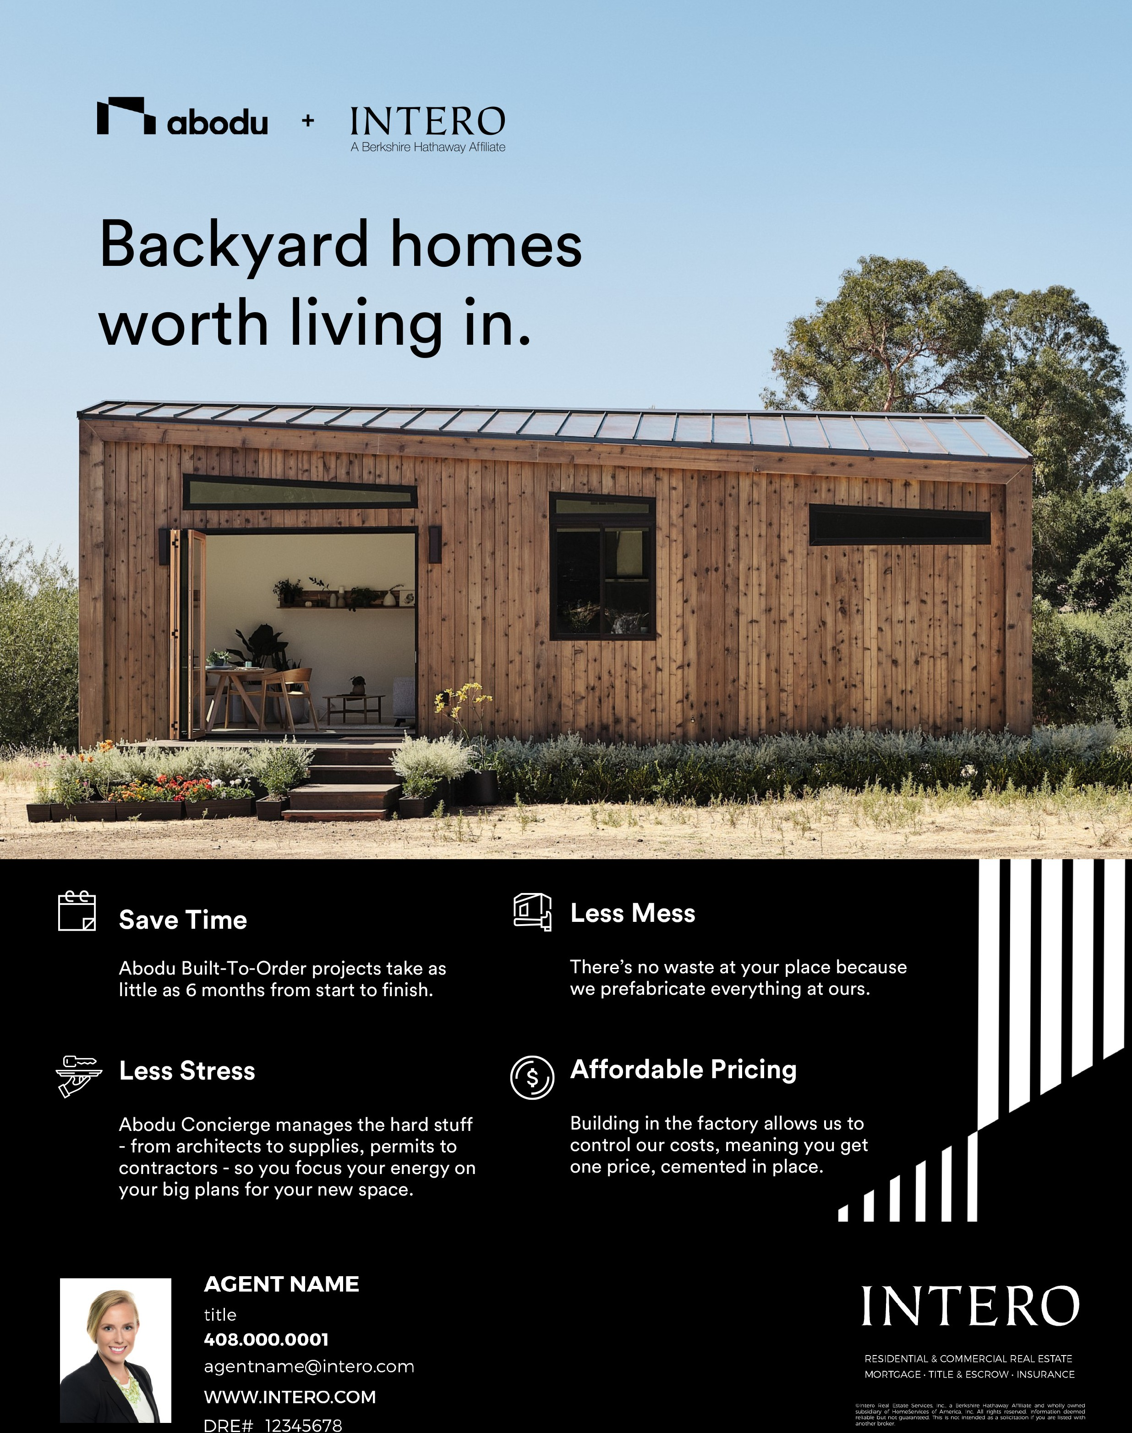
RESIDENTIAL & COMMERCIAL REAL ESTATE MORTGAGE • TITLE & ESCROW • INSURANCE
©Intero Real Estate Services, Inc., a Berkshire Hathaway Afﬁliate and wholly owned subsidiary of HomeServices of America, Inc. All rights reserved. Information deemed reliable but not guaranteed. This is not intended as a solicitation if you are listed with another broker.

Slide 10
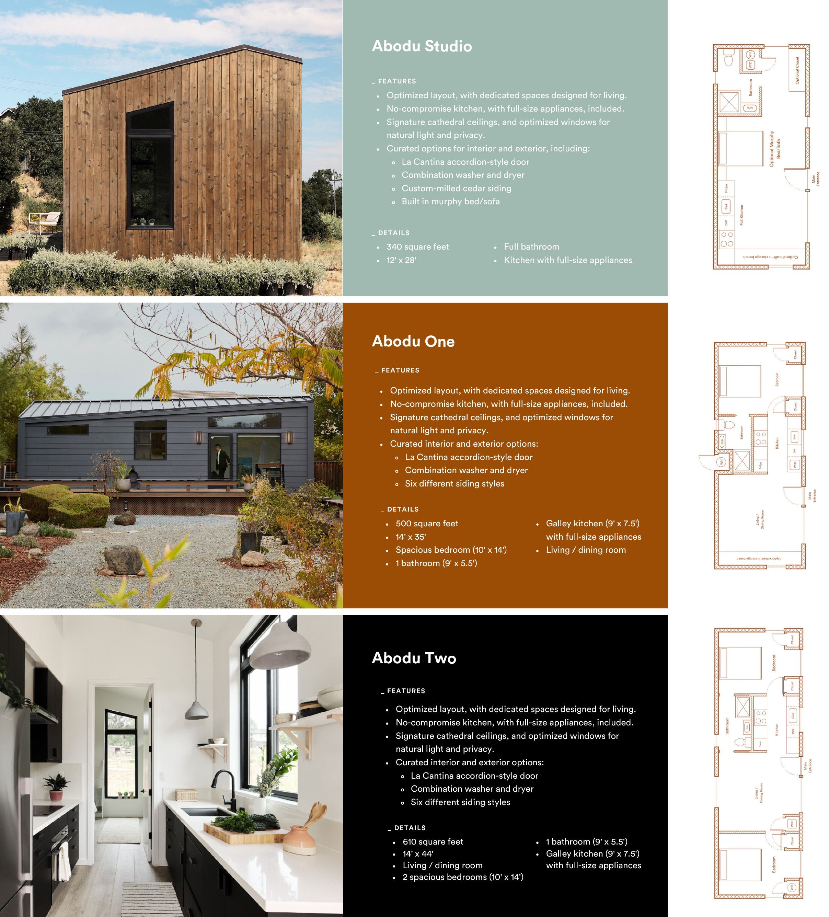
RESIDENTIAL & COMMERCIAL REAL ESTATE MORTGAGE • TITLE & ESCROW • INSURANCE
©Intero Real Estate Services, Inc., a Berkshire Hathaway Afﬁliate and wholly owned subsidiary of HomeServices of America, Inc. All rights reserved. Information deemed reliable but not guaranteed. This is not intended as a solicitation if you are listed with another broker.

Slide 11
SimpliSafe protects your home from break-ins, fire and flood 24/7. With security cameras, smart locks,
motion sensors and more, you’ll never have to worry about your family’s safety. It’s no wonder the US News
and World Report named SimpliSafe, “Best Overall Security System of 2020”.
SimpliSafe protects your home from break-ins, fire and flood 24/7. With security cameras, smart locks,
motion sensors and more, you’ll never have to worry about your family’s safety. It’s no wonder the US News
and World Report named SimpliSafe, “Best Overall Security System of 2020”.
Wendi Leibowitz Wendi.Leibowitz@simplisafe.com (609) 668-3344
Wendi Leibowitz Wendi.Leibowitz@simplisafe.com (609) 668-3344

Slide 12
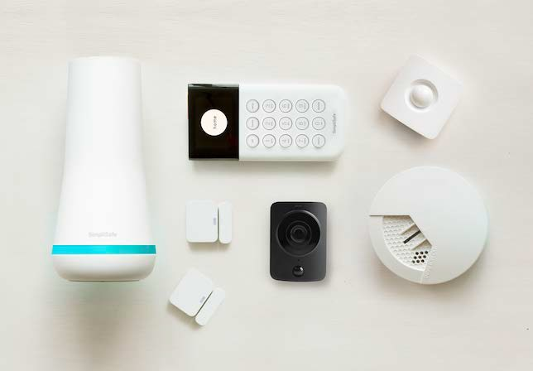
Protect Your Home. Protect Your Family.
In addition to offering you a wide variety of home financing options and services, Prosperity Home Mortgage, LLC wants to help you protect your biggest purchase and the people who live in it.
In partnership with SimpliSafe®, Prosperity is providing a complimentary smart home security system with every closed loan to protect what’s important to you.
Included in your complimentary SimpliSafe® Smart Home Security System (MSRP $423.92):
1 Base Station, 1 Keypad, 2 Entry Sensors, 1 Motion Sensor, 1 Smoke Detector, 1 WiFi HD Camera, 2 Months Interactive Professional Monitoring, Shipping Included
Borrowers are eligible for a SimpliSafe® home security system (MSRP $423.92) with a new purchase, secured by a first mortgage or deed of trust (New Loan), subject to qualification, approval and closing with Prosperity Home Mortgage. LLC. Loan must close within 60 days from the date of loan application. This offer must be presented at time of application and all eligibility requirements met no later than 2 days prior to the New Loan closing date. Only one SimpliSafe® home security system permitted per New Loan. This offer is void where prohibited and is non-transferable, subject to the terms herein, and valid on all complete applications received on or before 12/31/2021.
Prosperity Home Mortgage, LLC is not an affiliate of SimpliSafe®, Inc., and this off e r is n ot an endorsement of SimpliSafe® home security products or services.
This offer is for a limited time.
Contact a local mortgage consultant to redeem your complimentary SimpliSafe® security system.
All first mortgage products are provided by Prosperity Home Mortgage, LLC. (877) 275-1762. Prosperity Home Mortgage, LLC products may not be available in all areas. Not all borrowers will qualify. Licensed by the Department of Business Oversight under the California Residential Mortgage Lending Act. Licensed by the Delaware State Bank Commissioner. Massachusetts Mortgage Lender License ML75164. Licensed by the NJ Department of Banking and Insurance. Also licensed in AL, AR, AZ, CO, CT, DC, FL, GA, ID, IL, IN, KS, KY, LA, MD, ME, MI, MN, MO, MS, MT, NE, NC, ND, NH, NM, OH, OK, OR, PA, RI, SC, SD, TN, TX, UT, VA, VT, WA, WI, WV and WY.
NMLS #75164 (NMLS Consumer Access at http://www.nmlsconsumeraccess.org/)
©2021 Prosperity Home Mortgage, LLC. All Rights Reserved. (05/21)
#2146 Expires 12/31/2021

Slide 13
With Sunnova SunSafe solar and battery services, you can take control of your energy costs, increase Your resiliency to blackouts, and have the convenience of an EV charger bundled with your solar System through a leading residential solar and energy storage service provider. With Sunnova you can Easily switch to home solar and enjoy the benefits of clean energy.
With Sunnova SunSafe solar and battery services, you can take control of your energy costs, increase Your resiliency to blackouts, and have the convenience of an EV charger bundled with your solar System through a leading residential solar and energy storage service provider. With Sunnova you can Easily switch to home solar and enjoy the benefits of clean energy.
Anna Hagadorn Anna.Hagadorn@Sunnova.com (860) 335-8002
Anna Hagadorn Anna.Hagadorn@Sunnova.com (860) 335-8002

Slide 14
Get resilient backup power and increase your energy independence with our Sunnova SunSafe®solar+ battery storage service.¹
The Sunnova SunSafe® Advantage
CREATE AND STORE YOUR OWN POWER
Increase your energy independence by producing solar energy to power your home and storing excess energy in your battery for later.
TAKE CONTROL OF YOUR ENERGY COSTS
Protect yourself from rising utility rates. You can't predict what you will pay your utility, but you will always know what you'll pay for solar with Sunnova.
PROTECTION FROM PEAK RATES
Smart software automatically powers your home with solar energy during peak rate times to optimize your savings.
RESILIENT BACKUP POWER
When the grid goes down, Sunnova SunSafe® will power your essential appliances.¹
'The amount of power available from the battery during a power outage is limited, depending on the loads connected, customer usage and battery configuration (i.e. batteries in certain areas may be set up to provide you with the best economic benefit, which may affect the amount of back-up power available).
Solar systems and/or batteries may require repairs after weather events and such repairs may be delayed due to forces outside of our control. No assurances can be given that the solar system or the battery will always work. You should never rely upon either of these to power life support or other medical devices.
nnnv TM
www.sunnova.com
INTERO
A Berkshire Hathaway Affiliate

Slide 16
Google
Google
Security
Smart Home Technology
Entertainment
Security
Smart Home Technology
Entertainment

